Slide 1

Data Mining
CS-772
Department of
Computer Sciences

Slide 2
Measuring the Information Content of a Rule

Slide 3
Best Rules
Need to decide on some numerical value that we can measure for any rule which captures what we mean by ‘best’!
Calculation shows that for even as few as 10 attributes the number of possible rules is huge and in practice we may wish to restrict the rules of interest to some smaller (but possibly still very large) number.
As rules are generated we maintain a table of the best N rules so far found and their corresponding quality measures in descending numerical order.
If a new rule is generated that has a quality measure greater than the smallest value in the table the Nth best rule is deleted and the new rule is placed in the table in the appropriate position.

Slide 4
Search Space and Strategy
For example we might limit the rule ‘order’, i.e. the number of terms on the left-hand side, to no more than four (say) and possibly also place restrictions on the right-hand side, for example a maximum of two terms or only a single term or even only terms involving a single specified attribute.
We will call the set of possible rules of interest the search space.
Next; decide on a way of generating the possible rules in the search space in an efficient order, so that we can calculate the quality measure for each one.
This is called a search strategy.
Ideally, we would like to find a search strategy that avoids having to generate low-quality rules if possible

Slide 5
J-Measure
The J-measure was introduced into the data mining literature* as a means of quantifying the information content of a rule that is soundly based on theory.
Given a rule of the form
If Y = y, then X = x using Smyth and Goodman’s notation, the information content of the rule, measured in bits of information, is denoted by J(X; Y = y), which is called the J-measure for the rule.
* Smyth, P. and Goodman, R.M. (1992). Rule Induction Using Information
Theory. In Piatetsky-Shapiro, G. and Frawley, W.J. (eds.), Knowledge Discovery
in Databases, AAAI Press, pp. 159–176.

Slide 6
Cross-Entropy
The value of the J-measure is the product of two terms:
– p(y) The probability that the left-hand side (antecedent) of the rule will occur
– j(X; Y = y) The j-measure (note the small letter ‘j’) or cross-entropy.
The cross-entropy term is defined by the equation:
The value of cross-entropy depends on two values:
– p(x) The probability that the right-hand side (consequent) of the rule will be satisfied if we have no other information (called the a priori probability of the rule consequent)
– p(x|y) The probability that the right-hand side of the rule will be satisfied if we know that the left-hand side is satisfied (read as ‘probability of x given y’).

Slide 7
J-measure properties
In terms of the basic measures introduced earlier:
p(y) = N-LEFT /N-TOTAL
p(x) = N-RIGHT /N-TOTAL
p(x|y) = N-BOTH/N-LEFT
The J-measure has two helpful properties concerning upper bounds.
First, it can be shown that the value of J(X; Y = y) is less than or equal to p(y). log₂( 1/p(y) ).
The maximum value of this expression, given when p(y) = 1/e, is log₂ e/e, which is approximately 0.5307 bits.

Slide 8
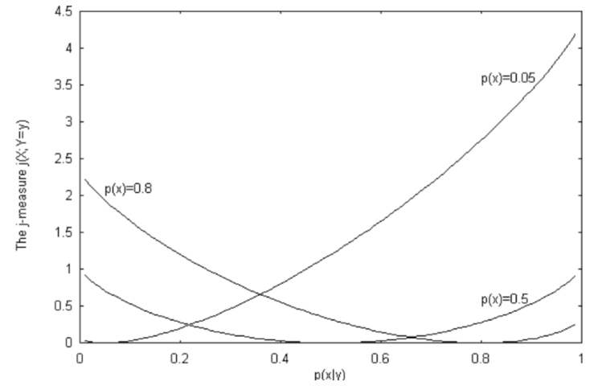
Plot of j-Measure for Various Values of p(x)

Slide 9
J-measure properties
Second (and more important), it can be proved that the J value of any rule obtained by specializing a given rule by adding further terms is bounded by the value
Thus if a given rule is known to have a J value of, say, 0.352 bits and the value of Jmax is also 0.352, there is no benefit to be gained (and possibly harm to be done) by adding further terms to the left-hand side, as far as information content is concerned.

Slide 10
Search Strategy
Assume that there are ten attributes a1, a2, . . . , a10 each with three possible values 1, 2 and 3.
The search space comprises rules with just one term on the right-hand side and up to nine terms on the left-hand side.
We start by generating all possible right-hand sides.
There are 30 of them, i.e. each of the 10 attributes combined with each of its three values, e.g. a1 = 1 or a7 = 2.
From these we can generate all possible rules of order one, i.e. with one term on the left-hand side. For each right-hand side, say ‘a2 = 2’, there are 27 possible left-hand sides, i.e. the other nine attributes combined with each of their three possible values, and thus 27 possible rules of order one, i.e.
IF a1 = 1 THEN a2 = 2
IF a1 = 2 THEN a2 = 2
IF a1 = 3 THEN a2 = 2
IF a3 = 1 THEN a2 = 2
IF a3 = 2 THEN a2 = 2
IF a3 = 3 THEN a2 = 2
and so on.

Slide 11
J-Value
We calculate the J-value for each of the 27 × 30 possible rules.
We put the rules with the N highest J-values in the best rule table in descending order of J.
The next step is to specialise the rules of order one to form rules of order two, e.g. to expand
IF a3 = 3 THEN a2 = 2 to the set of rules
IF a3 = 3 AND a1 = 1 THEN a2 = 2
IF a3 = 3 AND a1 = 2 THEN a2 = 2
IF a3 = 3 AND a1 = 3 THEN a2 = 2
IF a3 = 3 AND a4 = 1 THEN a2 = 2
IF a3 = 3 AND a4 = 2 THEN a2 = 2
IF a3 = 3 AND a4 = 3 THEN a2 = 2
and so on.
We can then go on to generate all rules of order 3 and then all rules of order 4, 5 etc. up to 9.
This clearly involves generating a very large number of rules.
There are 262,143 possible left-hand sides for each of the 30 possible right-hand sides, making a total of 7,864,290 rules to consider.

Slide 12
Computationally feasibility
Beam Search
Expand only the best (say) 20 rules of order one with an additional term.
The J-values of the resulting rules of order 2 are then calculated and the ‘best N rules’ table is adjusted as necessary.
The best 20 rules of order 2 (whether or not they are in the best N rules table overall) are then expanded by a further term to give rules of order 3 and so on.
This technique is known as a beam search, by analogy with the restricted width of the beam of a torch.
In this case the beam width is 20.
It is not necessary for the beam width to be a fixed value.
For example it might start at 50 when expanding rules of order one then reduce progressively for rules of higher orders.
It is important to appreciate that using a beam search technique to reduce the number of rules generated is a heuristic, i.e. a ‘rule of thumb’ that is not guaranteed to work correctly in every case.

Slide 13
Second Method
The second method of reducing the number of rules to be generated is guaranteed always to work correctly and relies on one of the properties of the J-measure.
Let us suppose that the last entry in the ‘best N rules table’ (i.e. the entry with lowest J-value in the table) has a J-value of 0.35 and we have a rule with two terms, say
IF a3 = 3 AND a6 = 2 THEN a2 = 2 which has a J-value of 0.28.
In general specialising a rule by adding a further term can either increase or decrease its J-value. So even if the order 3 rule
IF a3 = 3 AND a6 = 2 AND a8 = 1 THEN a2 = 2 has a lower J-value, perhaps 0.24
It is perfectly possible that adding a fourth term could give a higher J-value that will put the rule in the top N.
A great deal of unnecessary calculation can be avoided by using the Jmax value described previously.
As well as calculating the J-value of the rule
IF a3 = 3 AND a6 = 2 THEN a2 = 2 which was given previously as 0.28

Slide 14
Let us assume that we also calculate its Jmax value as 0.32.
This means that no further specialisation of the rule by adding terms to the left-hand side can produce a rule (for the same right-hand side) with a J-value larger than 0.32.
This is less than the minimum of 0.35 needed for the expanded form of the rule to qualify for the best N rules table.
Hence the order 2 form of the rule can safely be discarded.
Combining a beam search with rule ‘pruning’ using the Jmax value can make generating rules from even quite a large dataset computationally feasible.

Slide 15

Assignment
Develop a program for Basic Association Rule Mining and apply it on a small dataset;
Measure the complexity empirically.
Testing:-
The same implementation will be tested (emperically) for data sets used by other groups.

